Slide 1

Project Presentation Lattice Gas Automata (HPP, FHP)
01611822 Manuel Schieder

Slide 2
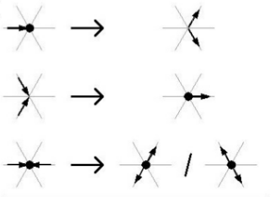

Introduction
HPP
Simple Model
Max. 4 Particles/Cell
16 possible states
1 collision rule
FHP
3 different Models
Up to 7 Particles/Cell
Up to 128 possible states
Up to 7 collision rule
[2]

Slide 3
Implementation
Node based Implementation
Apply collsion rules for particles
Apply collision rules at Boundaries & Obstacles
Propagate the particles
Average velocities for plotting
Domain
500x200 nodes
[2]

Slide 4
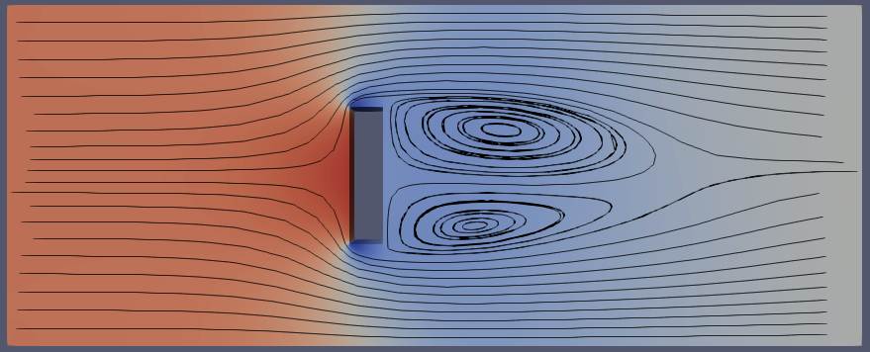
Test Case
[2]

Slide 5
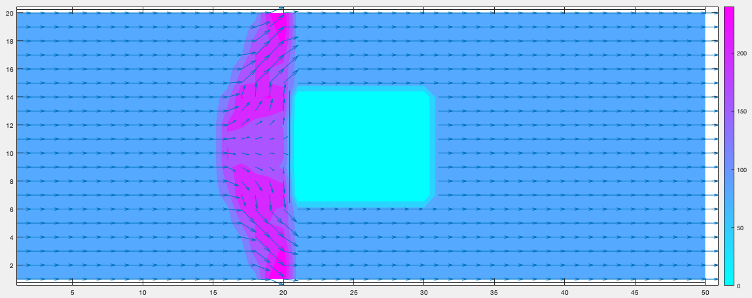
Results HPP
Particle density Contour with velocity vectors

Slide 6
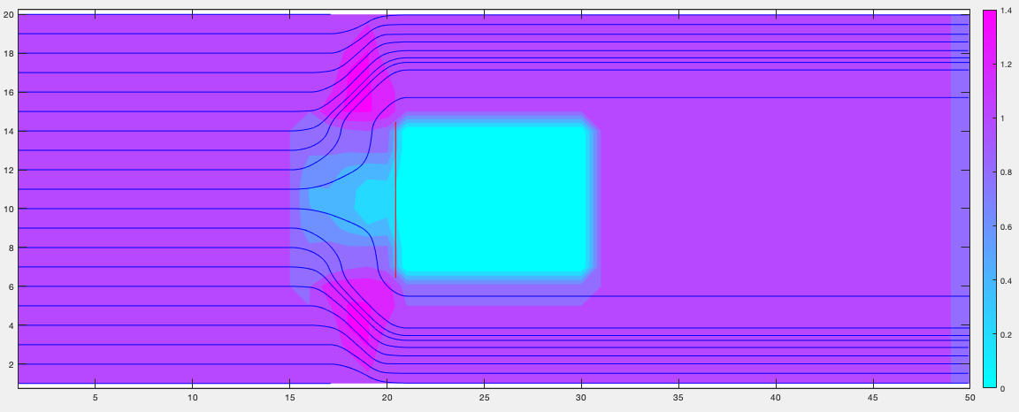
Results HPP
Velocity Contour with Streamlines

Slide 7
Results FHP
[2]

Slide 8
Karman Vortex Street
[2]

Slide 9
Conclusion
HPP
Good for a general idea of the flow field
No qualitative information about the flow
Energy is conserved (particles will never stop)

